Slide 1
A short history of using
in research and tech companies
Vienna R Meetup, Dec 17th
Christoph Töglhofer

Slide 2
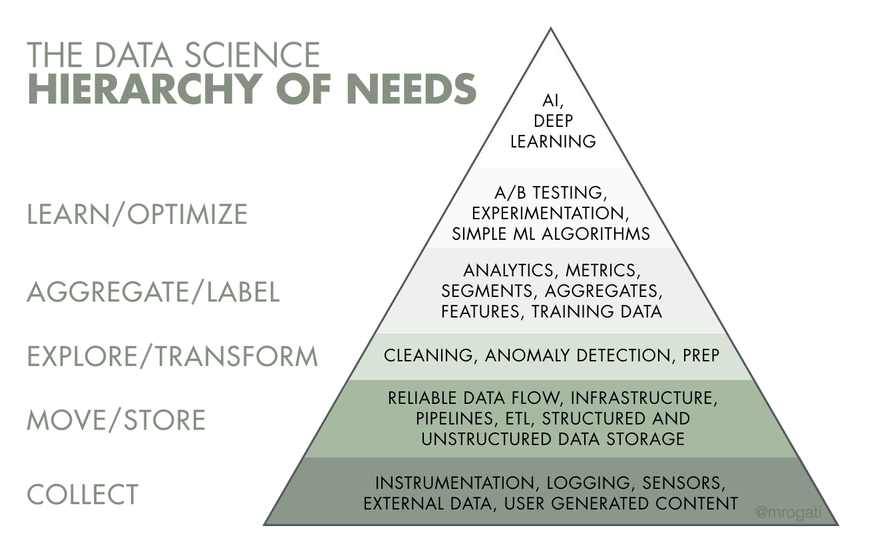
Source: Monica Rogati’s Medium post “The AI Hierarchy of Needs”

Slide 3
Data science skill evaluation

Slide 4
A T

Slide 5
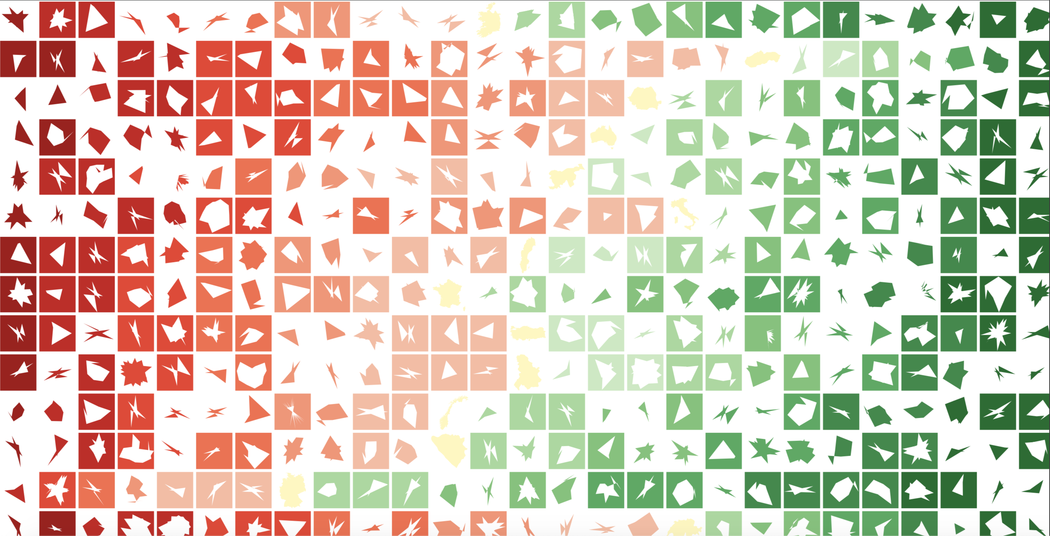

Slide 6
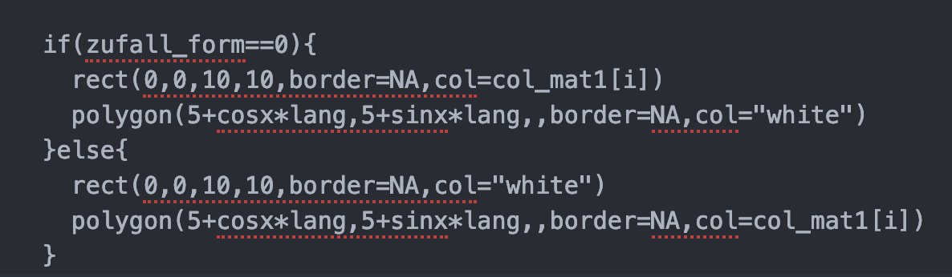

Slide 7

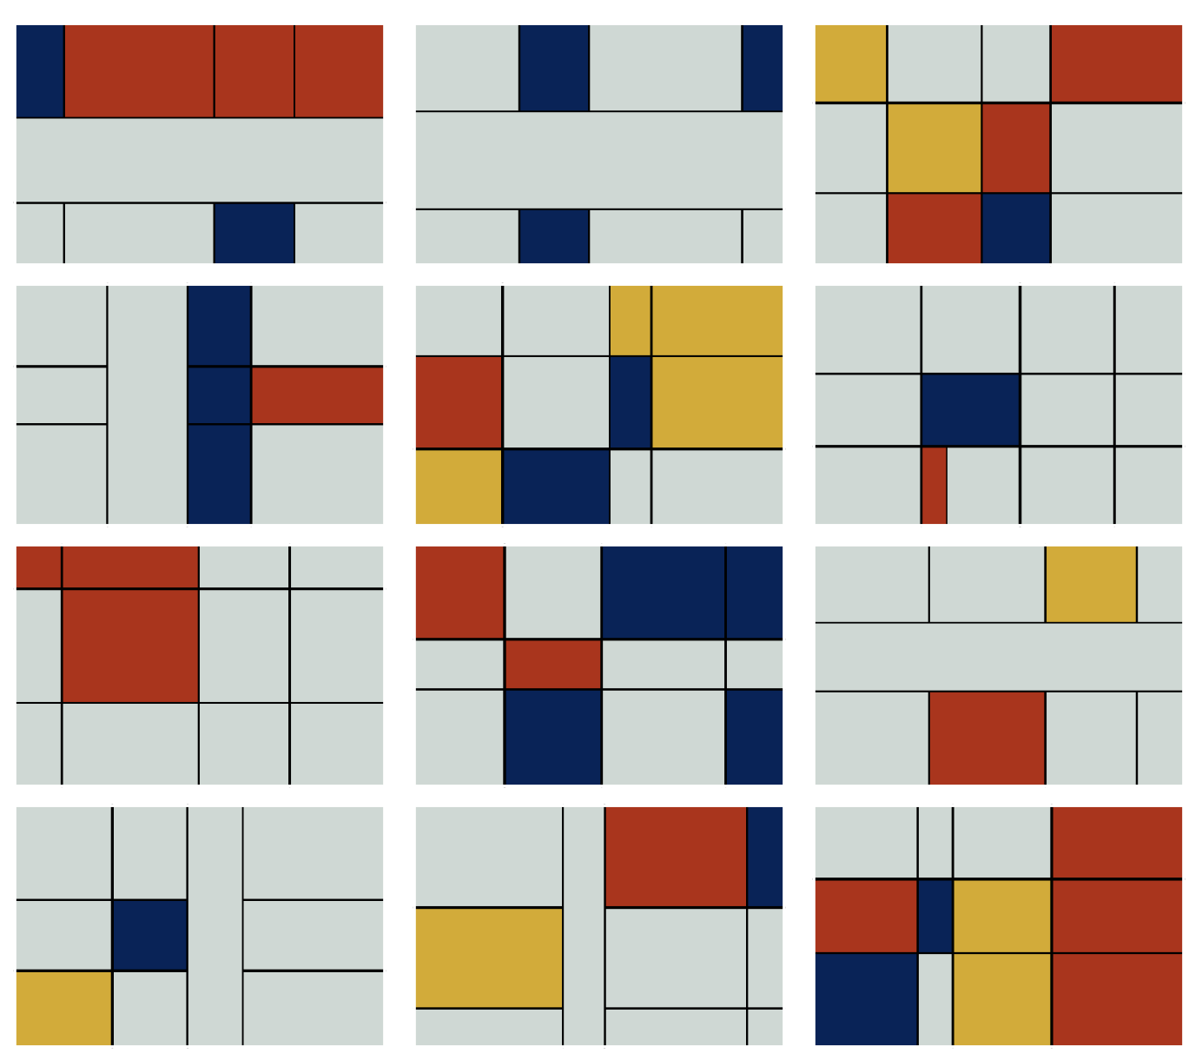
https://non-productivity-linked-ideas.shinyapps.io/Art_plot/

Slide 8
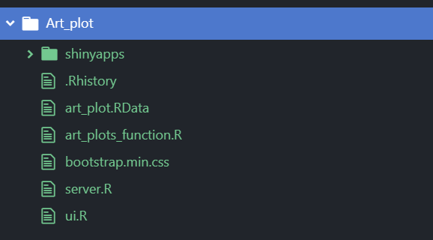
https://non-productivity-linked-ideas.shinyapps.io/Art_plot/

Slide 9
isk
is a combination of the probability of an event
and its potential impact

Slide 10
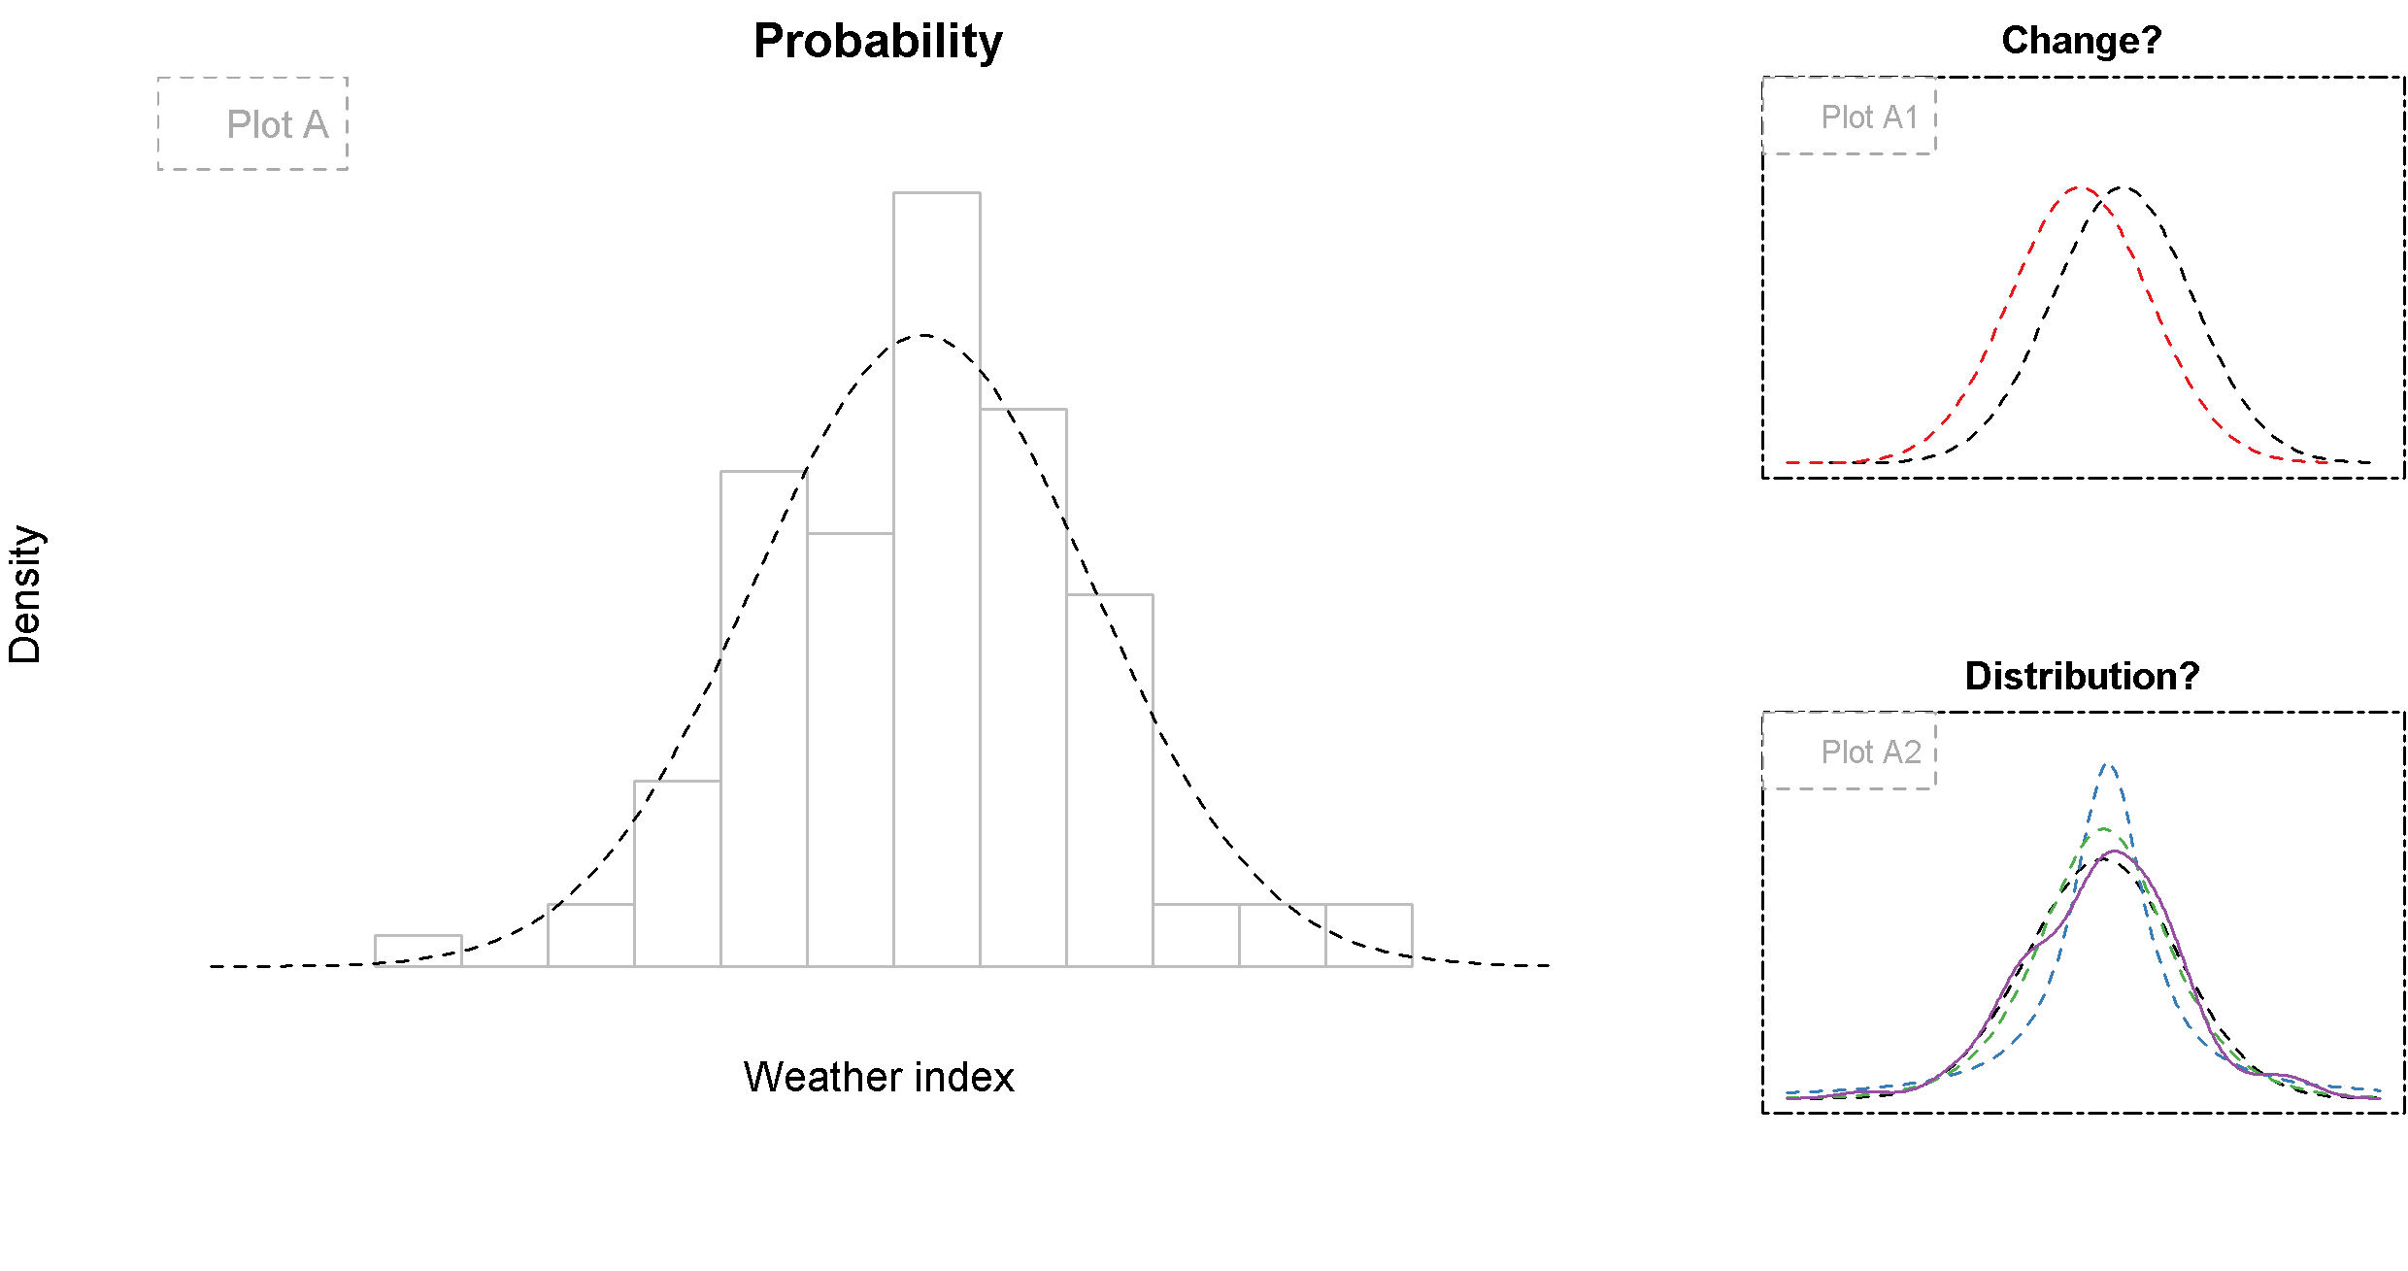

Slide 11
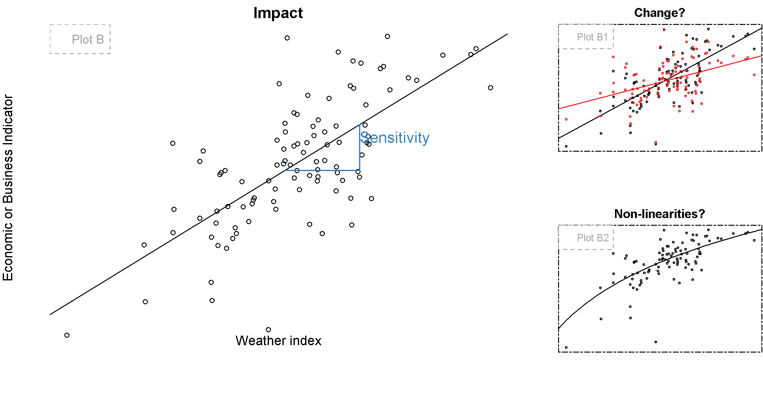

Slide 12
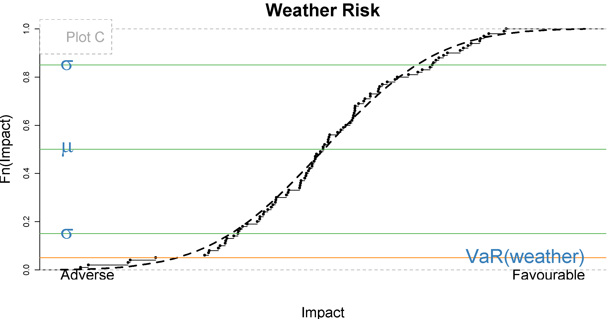

Slide 13
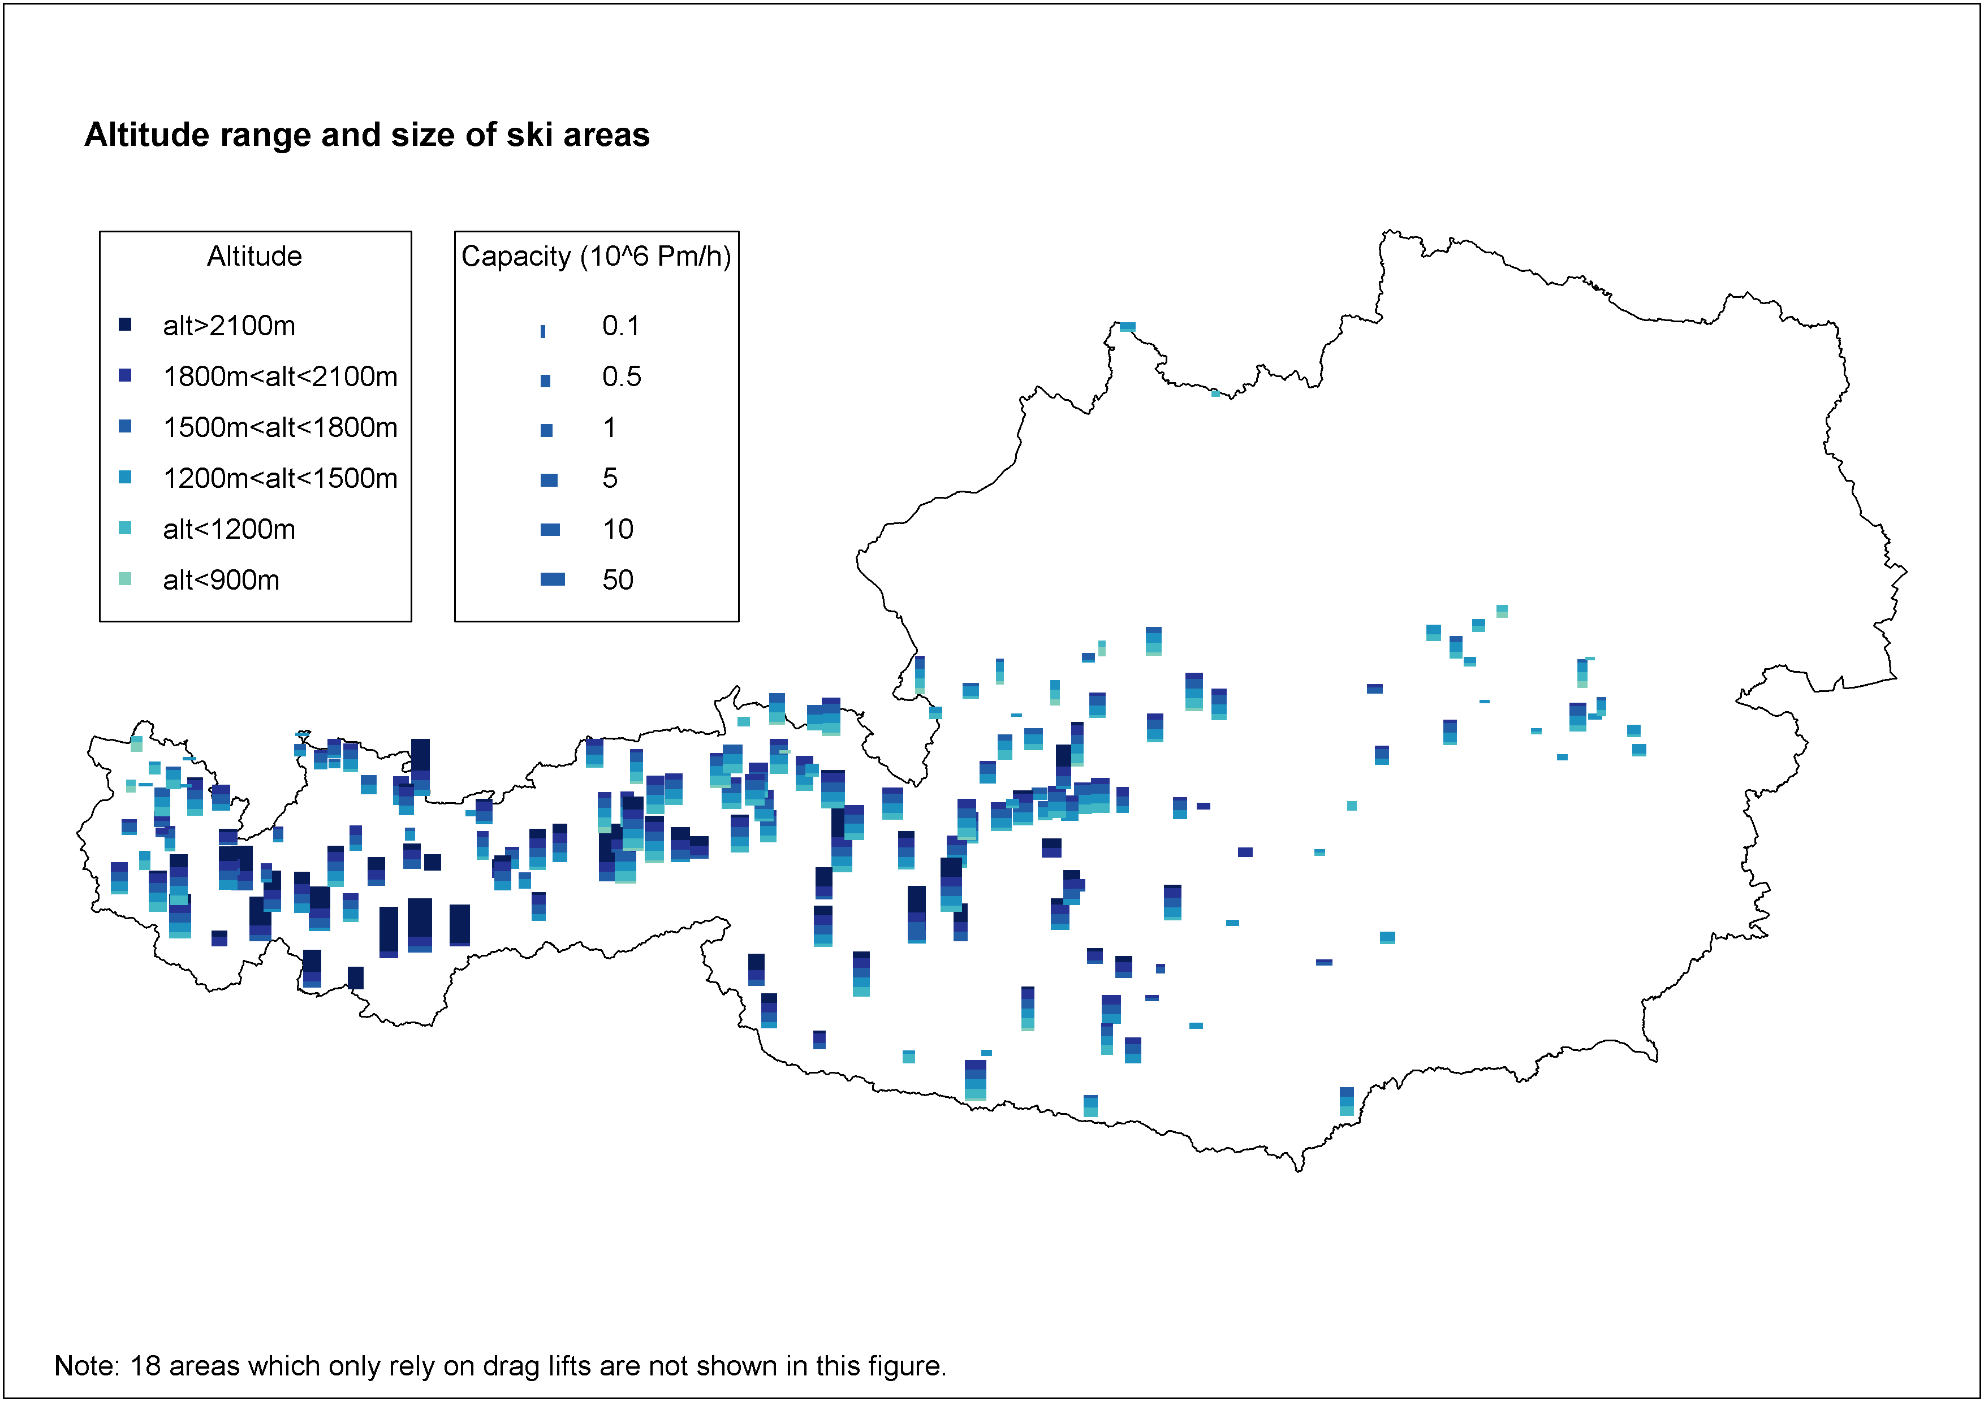

Slide 14
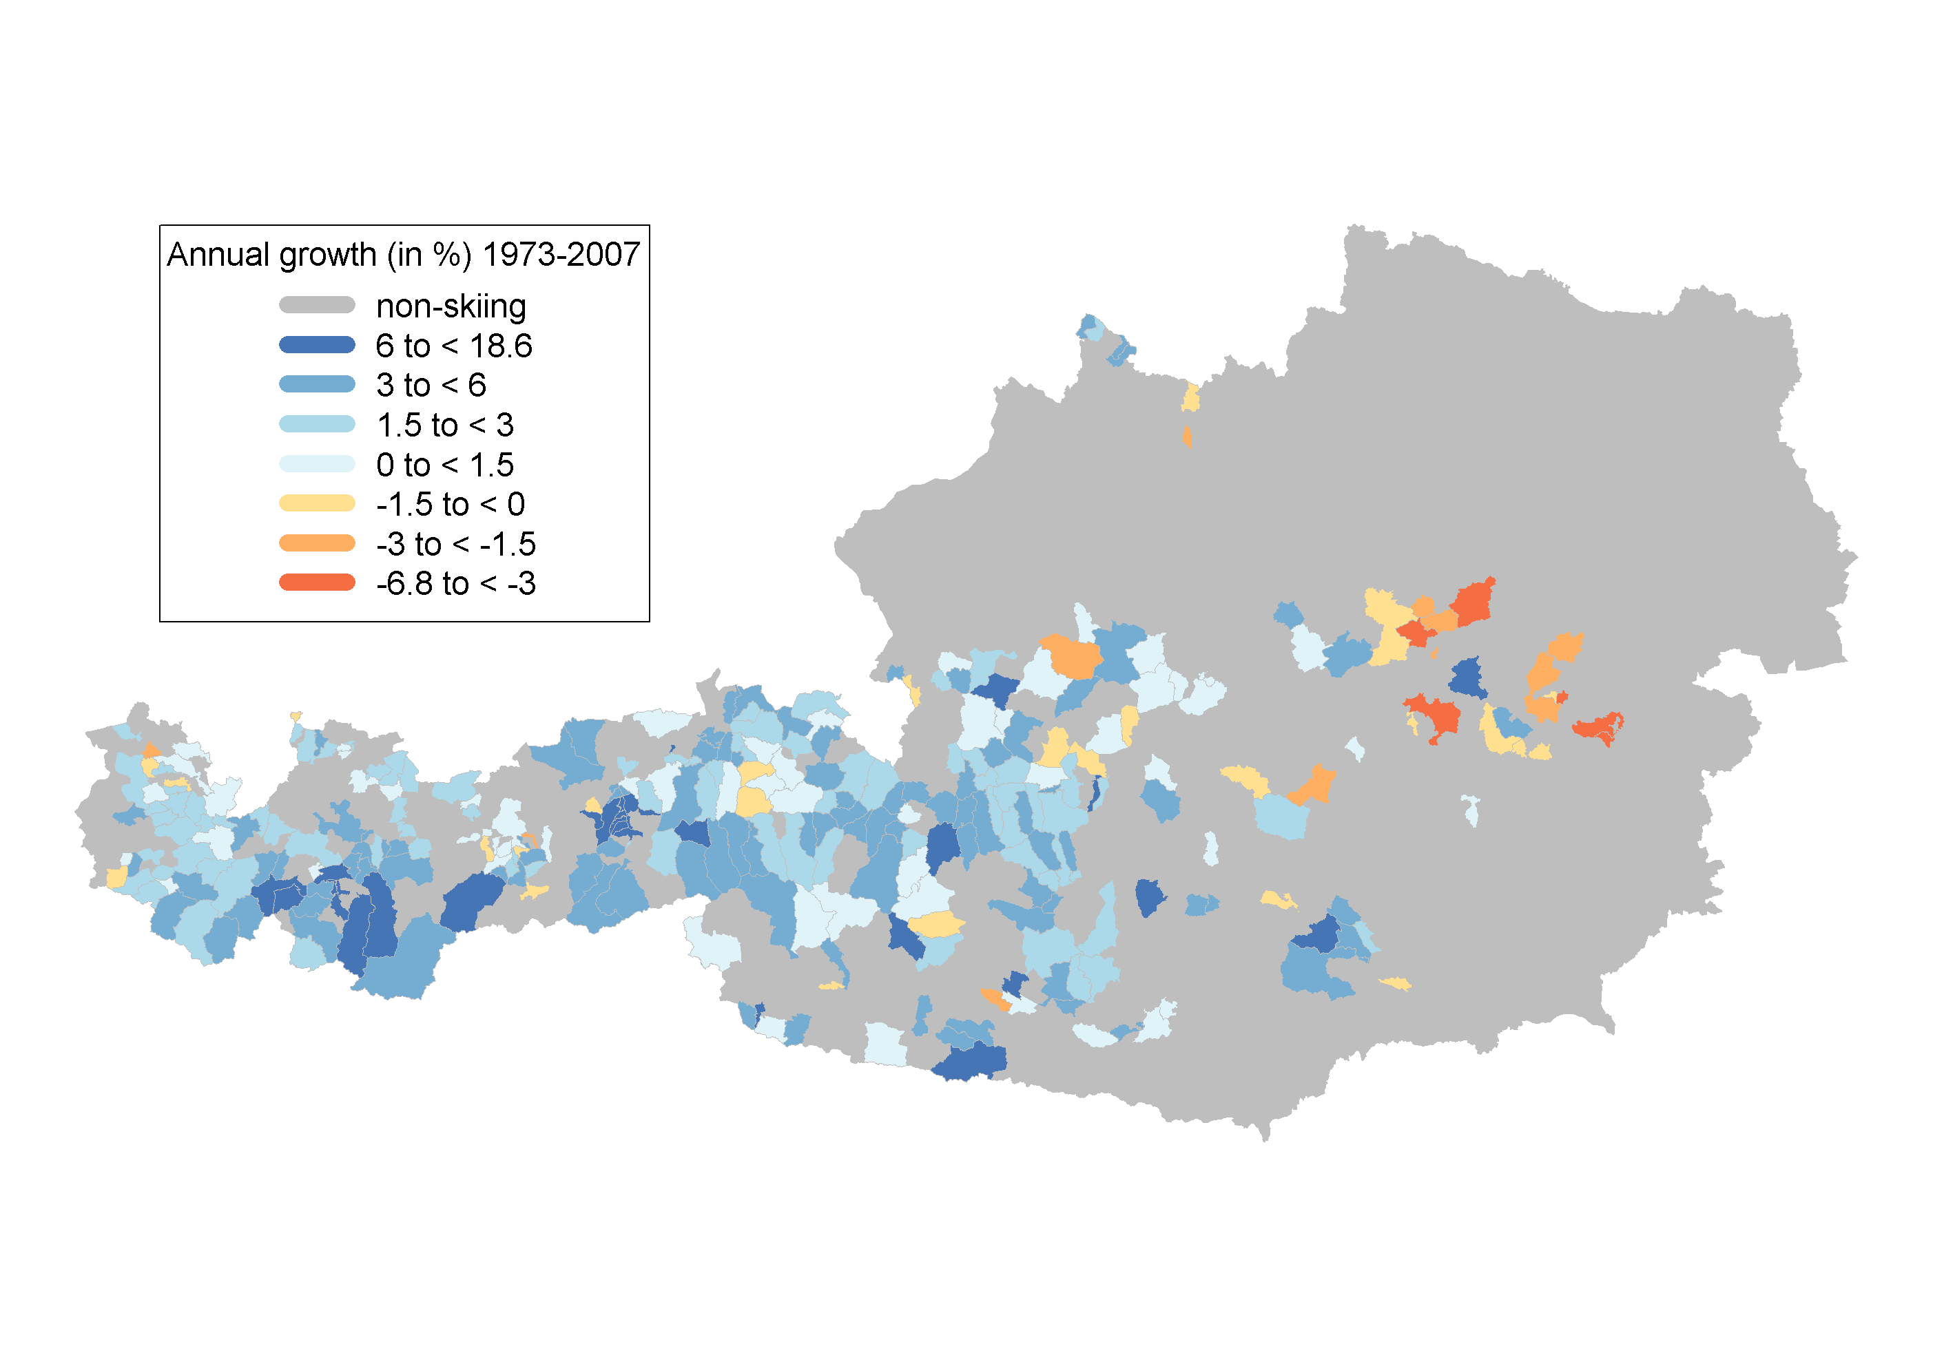
Overnight Stays

Slide 15
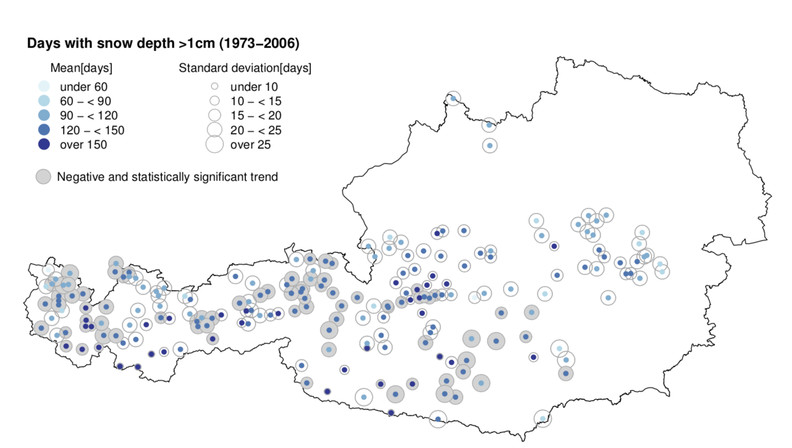

Slide 16
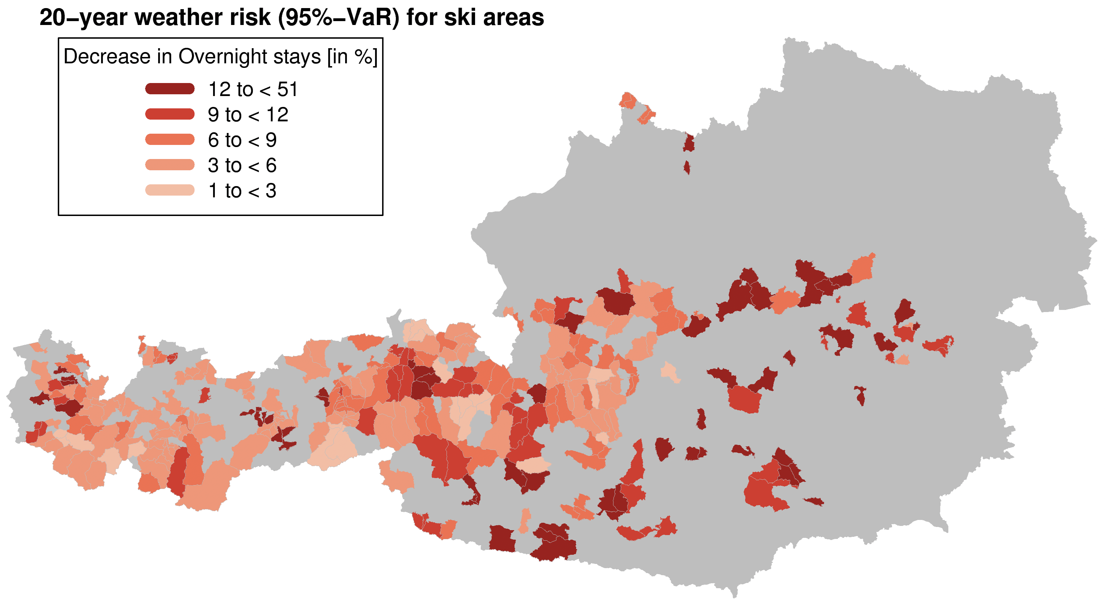

Slide 17
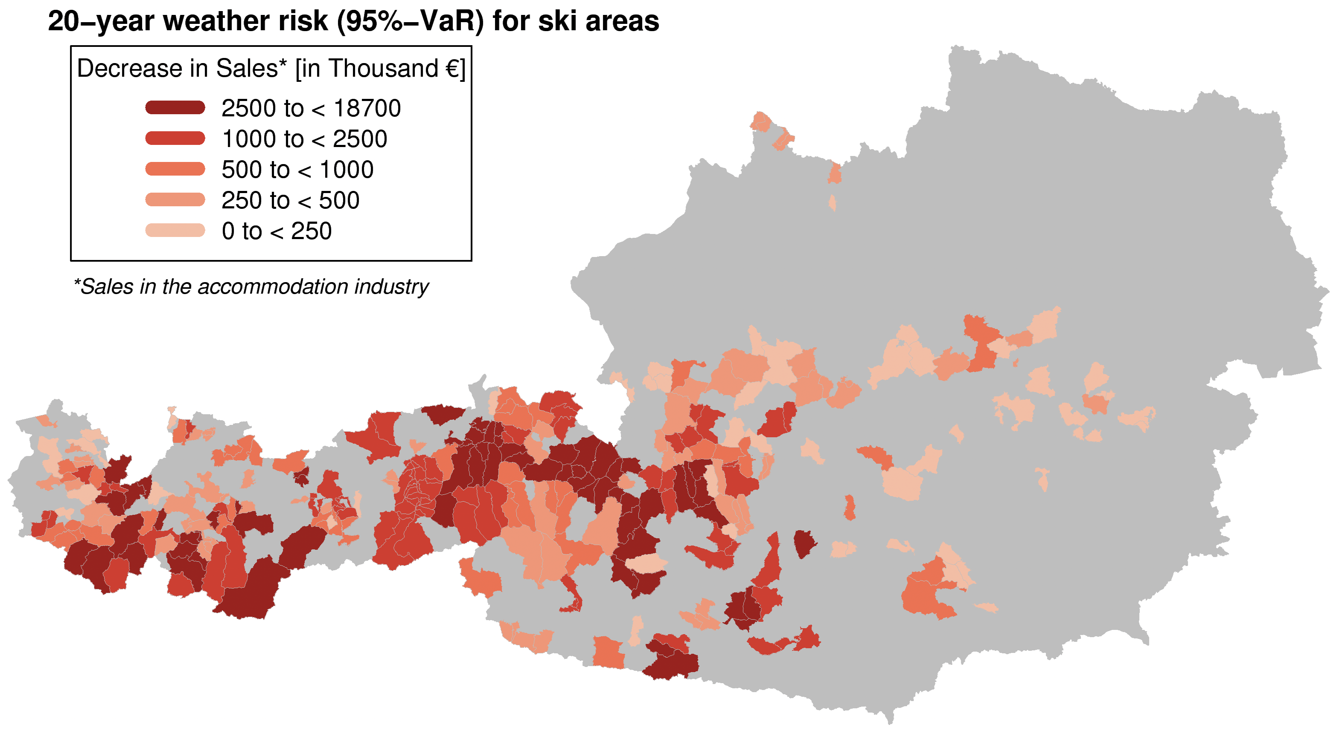

Slide 18
Elect icity

Slide 19
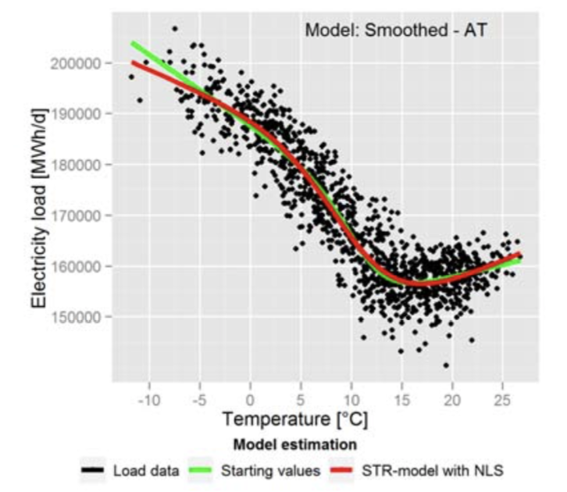
C. Töglhofer, C. Habsburg-Lothringen, F. Prettenthaler, N. Rogler, M. Themessl, 2012:
Impacts of Climate Change on Electricity Demand

Slide 20
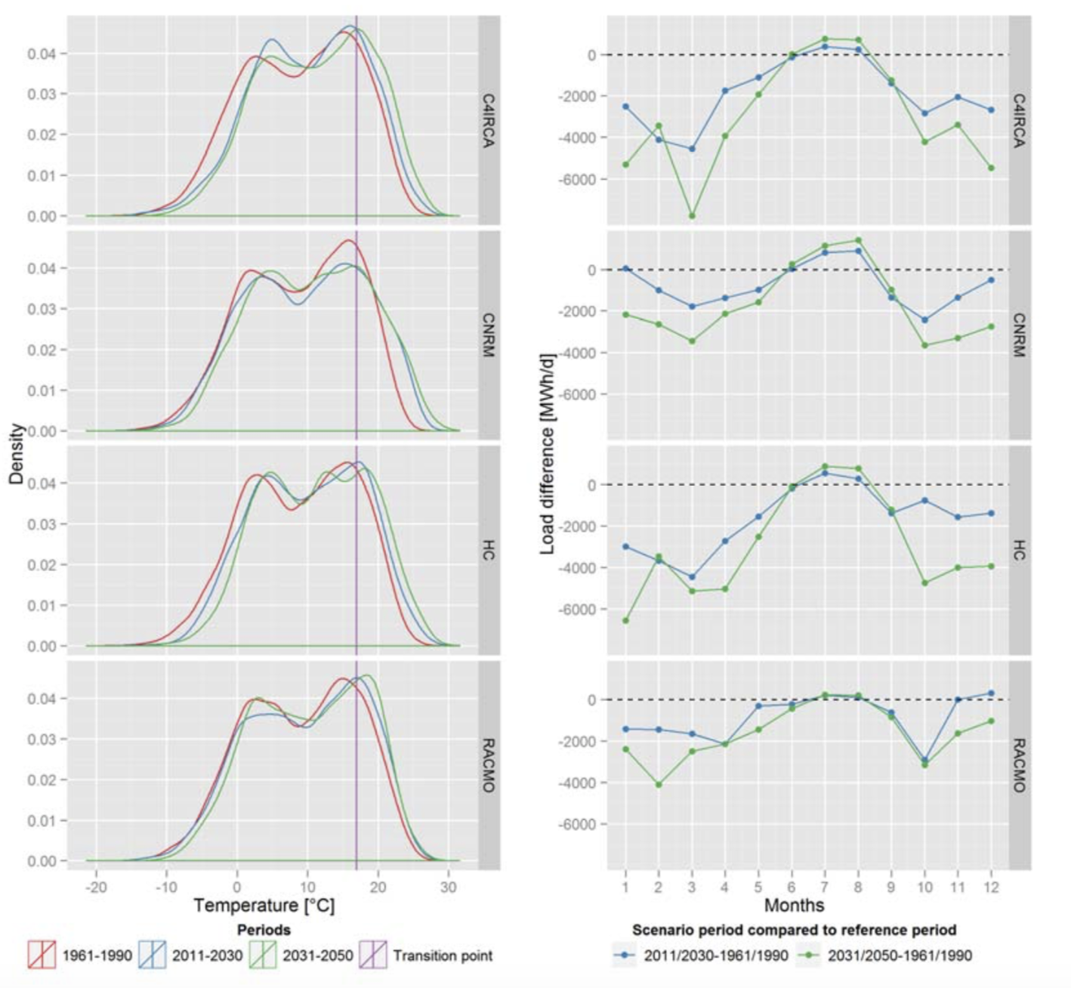

Slide 21
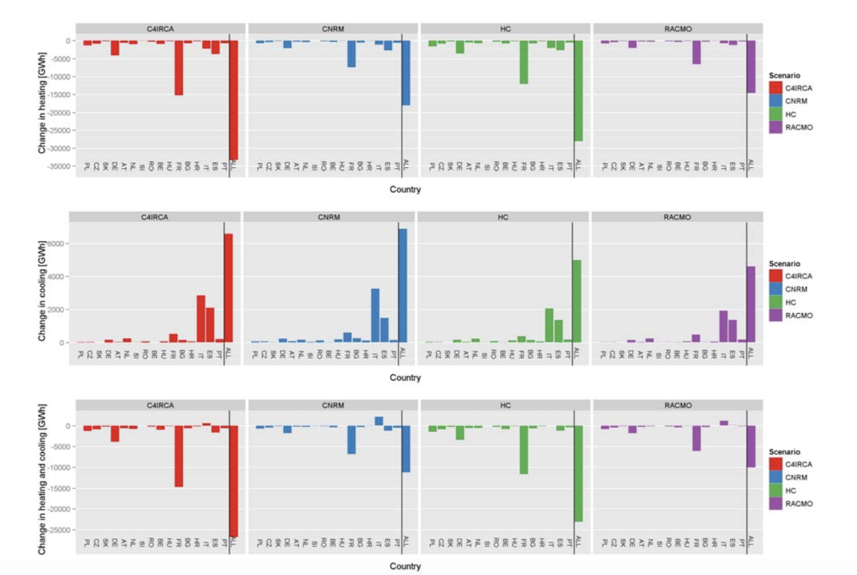

Slide 22
You Life

Slide 23
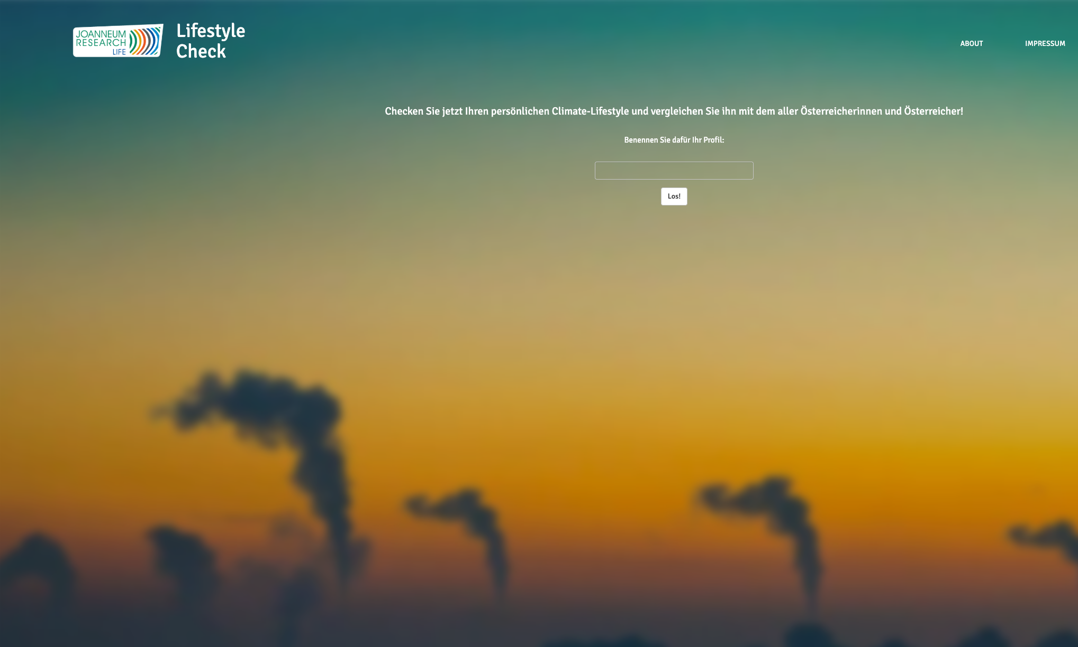
UI: Shiny
Chart:JS
Backend / models: R
R / JS
session$sendCustomMessage()
onInputChange().
jQuery, chart.js, Promises, future
https://lifestylecheck.at/

Slide 24
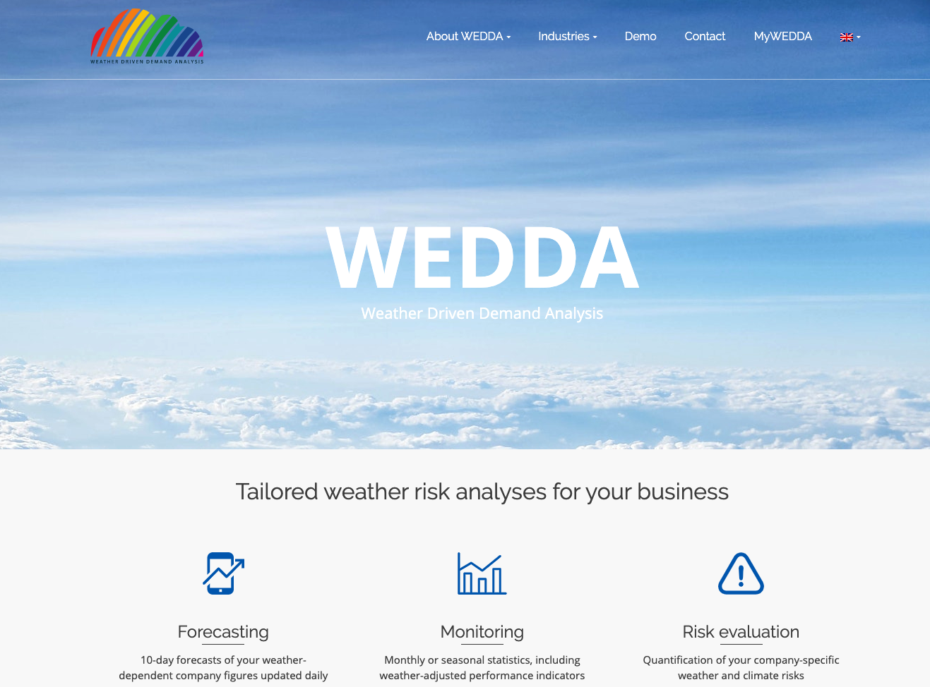

Slide 25
Perfo mance

Slide 27

Ge ge

Slide 28


Slide 29

https://george-labs.com/

Slide 30
Insights Sharing
Reporting Engine
Markdown
Flex Dashboard
Notebooks
Knowledge repo
https://github.com/airbnb/knowledge-repo
https://rmarkdown.rstudio.com/flexdashboard/

Slide 31
Tech Behind

Slide 32
P we up

Slide 33

https://george-labs.com/

Slide 34
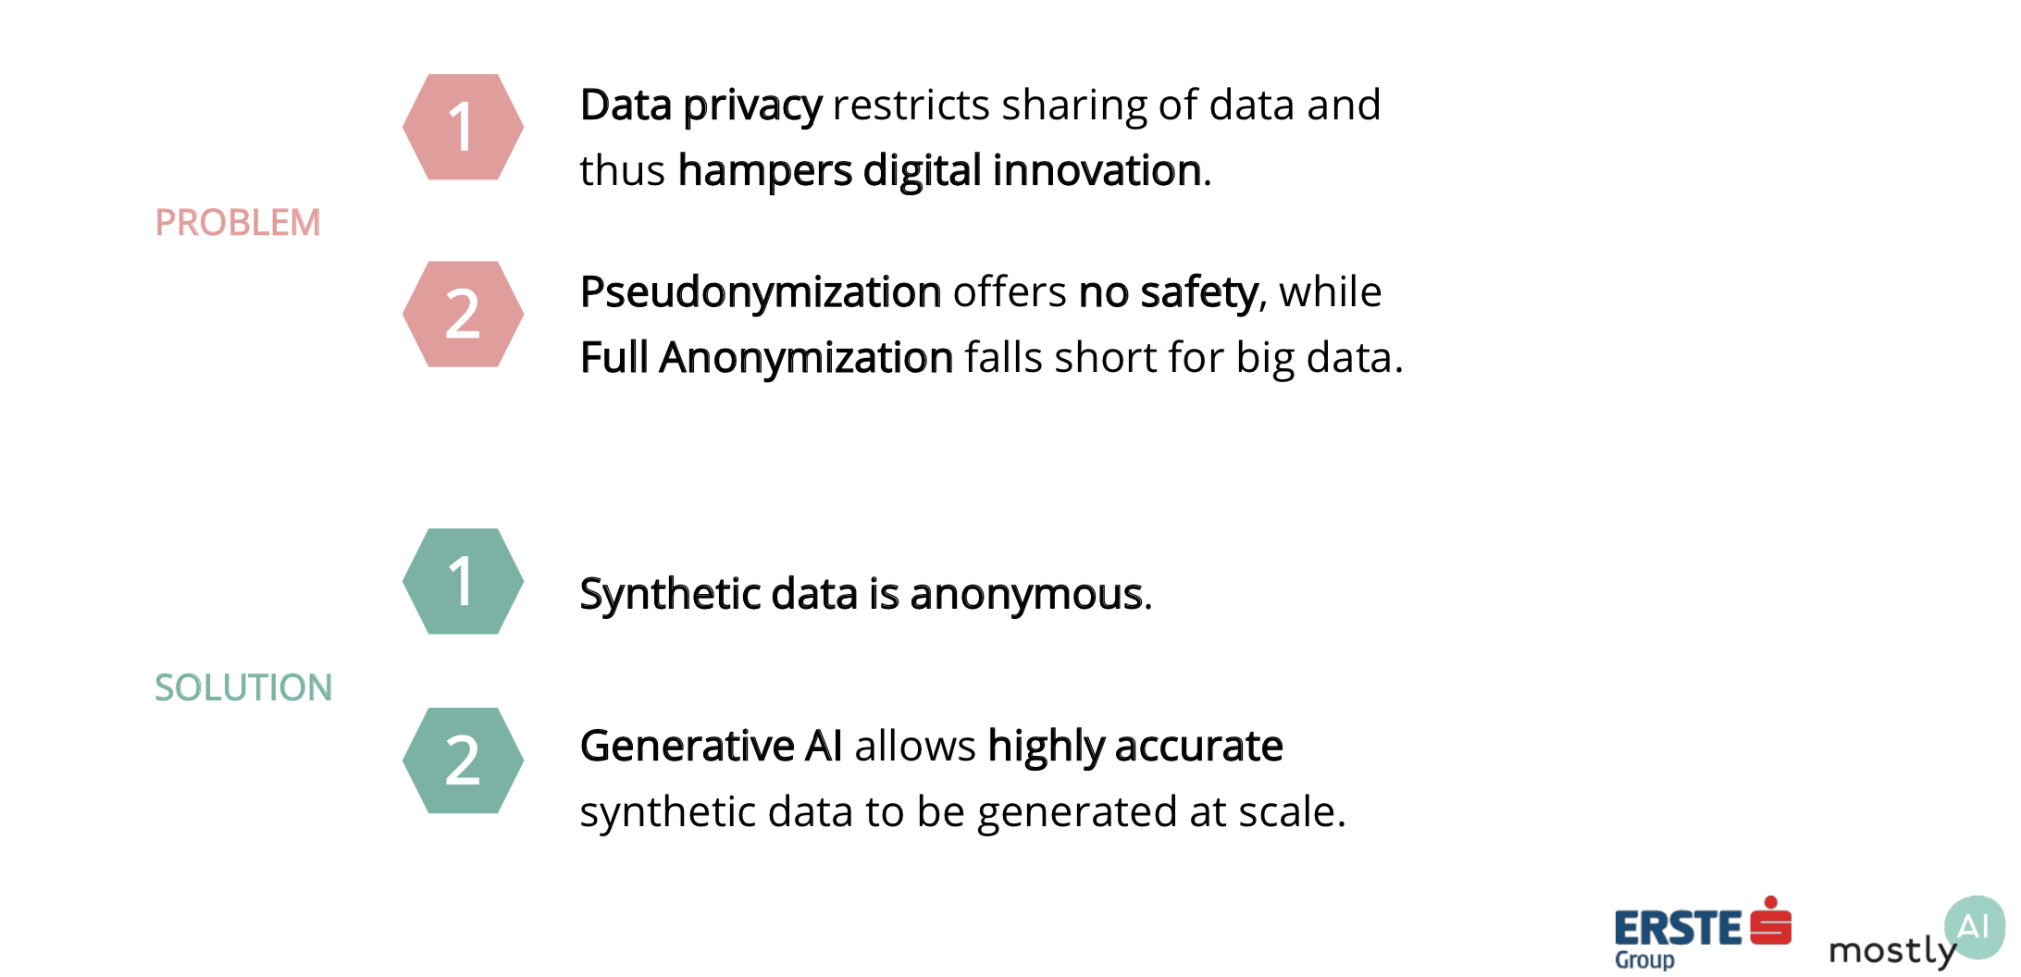
M. Platzer, C. Toeglhofer 2018: Privacy-Preserving Sharing of Financial Transaction Data with Deep Generative Models

Slide 35
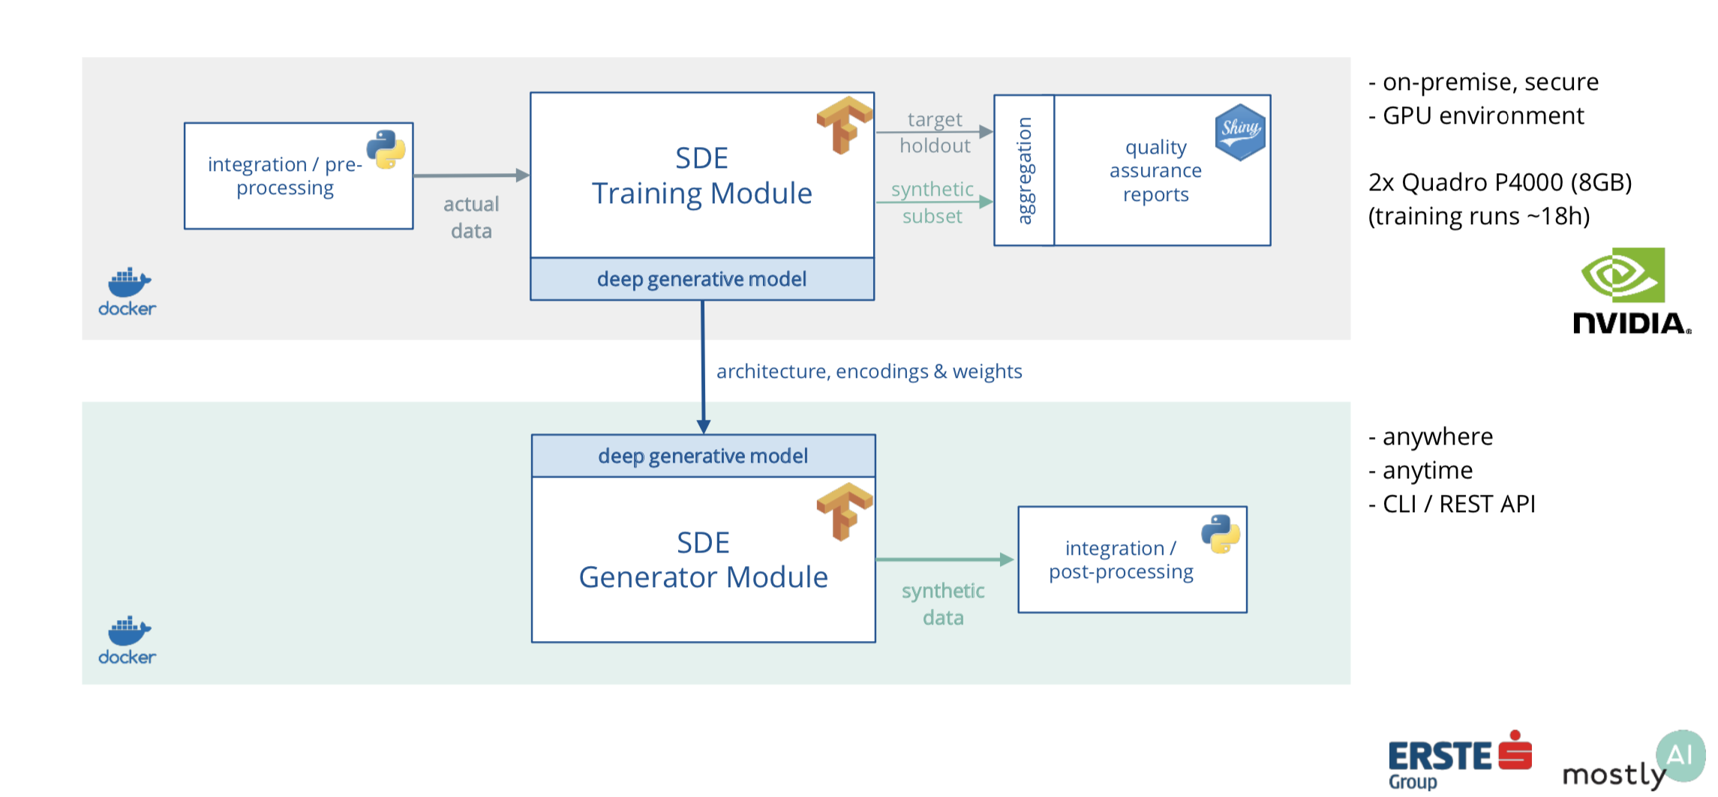
Tech Behind

Slide 36
https://github.com/ctoegi
https://at.linkedin.com/in/christoph-t%C3%B6glhofer-1870ab185

Slide 37


Thank you

